Slide 1
CONCURRENT/MULTITHREADING APLLICATION FOR REAL TIME BOOKING
Team Members
Renuka Boorsu
Lasyasree Guraka
Keerthi Thiragabathini
Venkataramana Navyasree Dandu
Akshitha Beniki

Slide 2
Contents:
Introduction
Block Diagram
Project Overview
Features
Pros
Conclusion

Slide 3
Introduction:
It is a web-based application. The main purpose of “Concurrent/Multithreading Application for Real Time Booking” is to provide a convenient way for a customer to choose the Places that they want to go and book cars and Buses for traveling purposes. The objective of this project is to develop a system that automates the processes and activities of a travel agency. In this project, we will make an easier task of bookings. In the present system a customer has to approach various agencies to find details of places and to book tickets. This often requires a lot of time and effort. By using this application these things are made easier task.

Slide 4
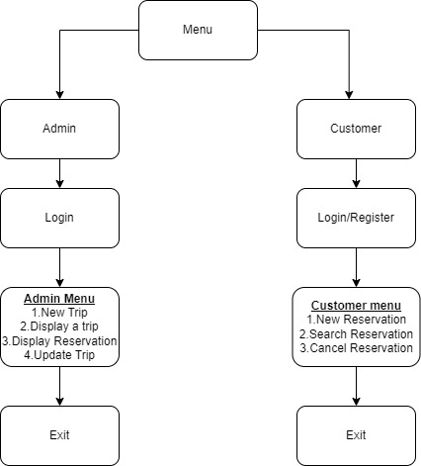
Block Diagram:

Slide 5
Project Overview:
The server process waits for requests from a client. To do this, the server first establishes (binds) an address that clients can use to find the server. When the address is established, the server waits for clients to request a service. By using threads, we can use multiple clients at a time
In client terminal first it binds with the server then it will ask for login through credentials after successful login we can access the functionalities of both admin side and customer side.

Slide 6
Features:
UDP SOCKET PROGRAMMING
MULTITHREADING
FILE HANDLING
SIGNAL HANDLING

Slide 7
Functionalities:
Admin
Customer
Login
New Trip
Display Trip
Display Reservations
Update a Trip
Login/Register
New Reservation
Choose Vehicle
Search Reservation
Cancel reservations

Slide 8
Pros
Multiple users can connect at a time
Easy Bookings for the customers
User Friendly
User can cancel the reservation at any time
Admin can do modifications trip details at any time
Available at 24/7

Slide 9
Conclusion:
This web application was successfully created and stored all the travel admin tourism packages booking and managing tour details into the database. This system thus provides an easy way to automate all the functionalities.

Slide 10

Thank You

